Slide 1



Auditing Requirements
Mike Scherr, Local Government Audit Manager

Slide 2


Agenda
N.D.C.C. 54-10-14 – Who Needs an Audit?
Audit Services
Single Audit Changes
Annual Review Process
Q&A
Notes:
To replace the photo from slide 7, use this slide and follow these steps:
1. Drag and drop or copy and paste your image into this slide
2. Right click your image and choose “Send to Back”
3. Position your image behind the shapes so that the shape is concealing the part of the image you want to show
4. Select your image (make sure you select the image you want to ultimately show first), then hold down shift and select the shape
5. With both selected, go to the tab “Shape Format” (top right of the ribbon)
6. With both still selected, at the bottom left of the ribbon, select “Merge Shapes” > “Intersect”
*If you have any problems, reach out to Shiri!

Slide 3
NDCC 54-10-14
Auditing requirements
$2 million audit threshold
Financial statement audit
Annual Financial Review
https://ndlegis.gov/cencode/t54c10.pdf

Slide 4


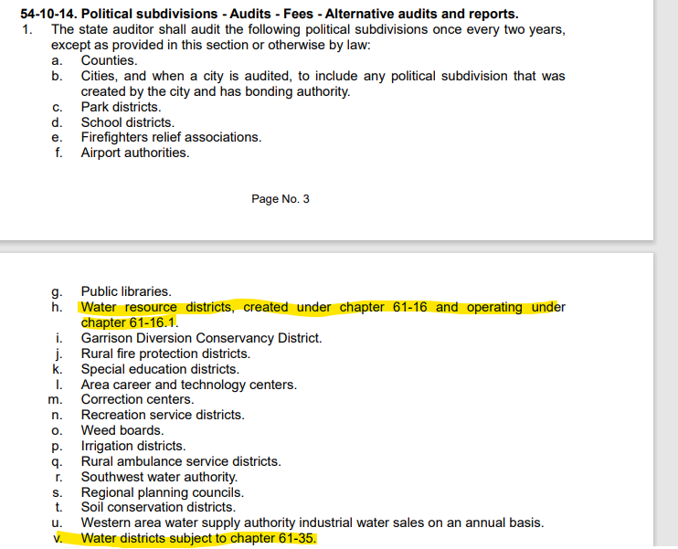
NDCC 54-10-14

Slide 5

Who needs an Audit?
Are you an entity listed in NDCC 54-10-14?
Do you have over $2,000,000 in annual receipts (revenues)?
Do you need a federal single audit?
Is legislation requiring you to get an audit?
Is an oversight agency or bonding requiring an audit?
If you answered yes to any of these, you will need an audit.
Any CPA firm can do your audit, not just the State Auditor’s Office.
Reach out to several firms to get best quote.

Slide 6
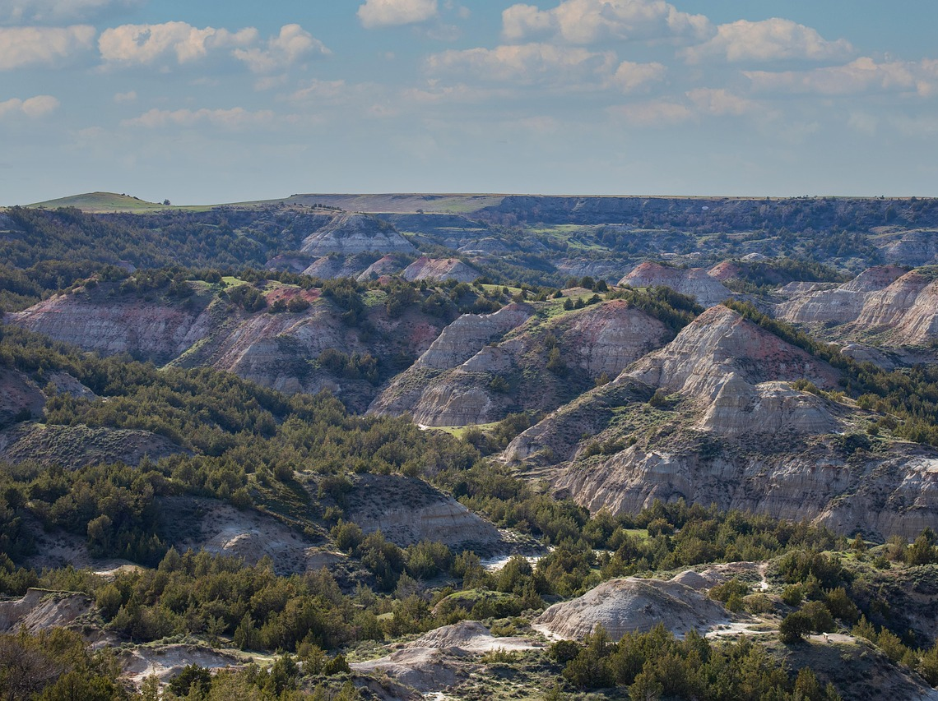
Single Audit Requirement
Audit of Federal expenditures
750k threshold
2025 threshold increase to $1 Million
Periods ending Sep. 30, 2025
Notes:
To replace the photo from slide 9, use this slide and follow these steps:
1. Drag and drop or copy and paste your image into this slide
2. Right click your image and choose “Send to Back”
3. Position your image behind the shapes so that the shape is concealing the part of the image you want to show
4. Select your image (make sure you select the image you want to ultimately show first), then hold down shift and select the shape
5. With both selected, go to the tab “Shape Format” (top right of the ribbon)
6. With both still selected, at the bottom left of the ribbon, select “Merge Shapes” > “Intersect”
*If you have any problems, reach out to Shiri!

Slide 7
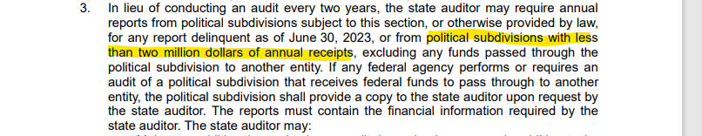
Annual Review Process
For smaller entities that have less than $2,000,000 in annual receipts (revenues).
Free of charge – no cost to the entity
Team reviews in order received.
Annual financial report – can include comments.
Website – has information on the review process
https://www.nd.gov/auditor/forms

Slide 8
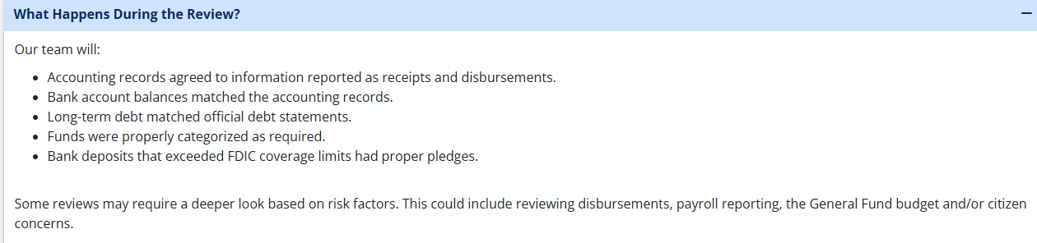
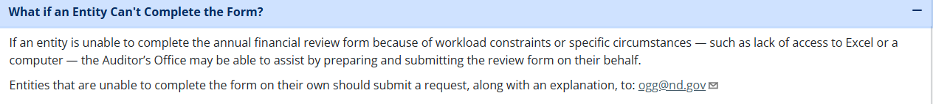
Annual Review Process

Slide 9
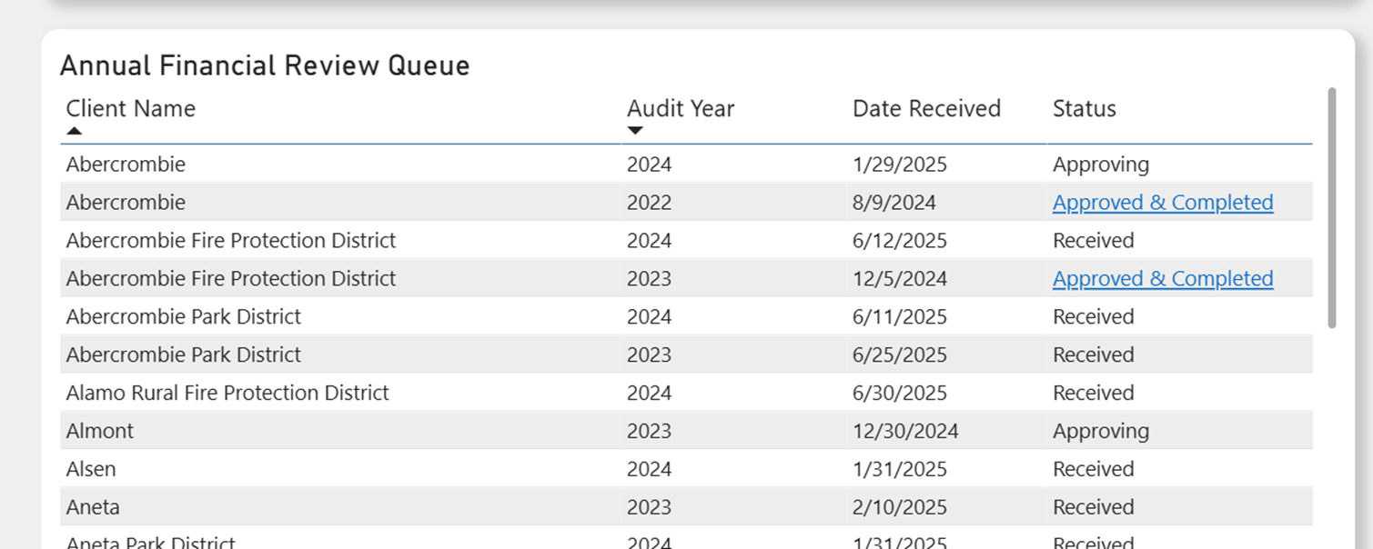
Annual Financial Review Queue
Annual Financial Review Queue | State Auditor's Office

Slide 10

What if you’re past due?
We’re here to help – contact our office!
We will work with you to get current
Schedule a free consultation
The Learning Series
Free, one-hour virtual training series designed specifically for local government professionals handling accounting functions in small North Dakota governments.
https://www.nd.gov/auditor/OGG
Notes:
Talk about getting help with your books, from a firm

Slide 11




Mike Scherr - Audit Manager
Office of Good Government
701.328.9500
mascherr@nd.gov
nd.gov/auditor
701.328.9083
ogg@nd.gov
nd.gov/auditor
Notes:
To add your headshot, follow these steps:
Drag and drop or copy and paste your image into this slide
Right click the grey circle and choose “Bring to Front”
Position/resize your image behind the circle so that the circle shows your whole face
Select your image, then hold down shift and select the grey circle
With both selected, go to the tab “Shape Format” (top right of the ribbon)
With both still selected, at the bottom of left of the ribbon, select “Merge Shapes” > “Intersect”

